Slide 1
DATA PREPROCESSING

Slide 2
WHAT IS DATA PREPROCESSING?
To make data more suitable for data mining.
To improve the data mining analysis with respect to time, cost and quality.

Slide 3
WHY PREPROCESSING?
Data in the real world is dirty
  incomplete: missing attribute values, lack of certain attributes of interest, or containing only aggregate data
    e.g., occupation=“”
  noisy: containing errors or outliers
    e.g., Salary=“-10”
  inconsistent: containing discrepancies in codes or names
    e.g., Age=“42” Birthday=“03/07/1997”
    e.g., Was rating “1,2,3”, now rating “A, B, C”
    e.g., discrepancy between duplicate records

Slide 4
WHY IS DATA PREPROCESSING IMPORTANT?
No quality data, no quality mining results!
  Quality decisions must be based on quality data
    e.g., duplicate or missing data may cause incorrect or even misleading statistics.

Slide 5
DIFFERENT PREPROCESSING TECHNIQUES
Data Cleaning
Data Integration
Data Transformation
Data Reduction

Slide 6
KNOWING ABOUT DATA

Slide 7
WHAT IS DATA?
DATA (samples, Instances, Data points, Objects)
Collection of data objects- Customers, students
ATTRIBUTE ( Dimensions, Features, Variables)
An attribute is a property or characteristic of an object
  Examples: eye color of a person, temperature, etc.
Observed values for a given attribute known as OBSERVATIONS
ATTRIBUTE VECTOR the set of attributes used to describe an object.
UNIVARIATE: The distribution data involving one attribute
BI VARIATE: The distribution data involving two attributes

Slide 8

WHAT IS DATA?

Slide 9
TYPES OF ATTRIBUTES
NOMINAL
BINARY
ORDINAL
NUMERIC
Interval Scaled
Ratio Scaled
Discrete Attributes
Continuous Attributes

Slide 10
TYPES OF ATTRIBUTES
Nominal/ Categorical
The values of a nominal attribute are “Symbols or Name of the thing,” i.e., nominal attributes provide only enough information to distinguish one object from another.
Examples
Employee ID numbers, Eye Color, Hair color.
The values may be numerical values but the mathematical calculation on the attribute wont reflect any a meaning
Operations
mode,
entropy,
contingency correlation,
χ² test

Slide 11
TYPES OF ATTRIBUTES
Binary/Boolean
The values may be 0/1 and True/False
Like Nominal value
Examples:
Medical_Test, Smoker
Types:
Symmetric Binary: Both outcome states are equally
weighted Gender
Asymmetric Binary: The Outcomes of the states or not equally important. Medical_Test

Slide 12
TYPES OF ATTRIBUTES
Ordinal
The ordinal attribute values are possible values that have meaningful order.
Examples
rankings(hardness of minerals, {good, better, best}, )
Grades( A+,A,A-,B+,B,B- ……)
Professional_Rank(Assistant Professor, Associate Professor, Professor)
Students_feedback_form(1to 5 1. poor 5. very good)
Operations
median, Mode
percentiles, Rank correlation,

Slide 13
TYPES OF ATTRIBUTES- NUMERICAL
A numerical attribute is quantitative.i.e, it is a measurable quantity, represented in integer or real values. It can be interval scaled or ratio-scaled.
INTERVAL : Measured on Scale of Equal size units
For interval attributes, the differences between values are meaningful, i.e., a unit of measurement exists.
Examples
Calendar dates, temperature in Celsius or Fahrenheit,
Operations
Mean, Median
standard deviation,
Pearson's correlation,
t and F tests

Slide 14
TYPES OF ATTRIBUTES –NUMERICAL
RATIO
It is a numeric attribute with an inherent zero - point. For ratio variables, both differences and ratios are meaningful.
That is we can speak of values as being multiple of another values.
Examples
temperature in Kelvin, Length, Experience, Populations
Operations
geometric mean,
harmonic mean,
percent variation

Slide 15
QUALITATIVE AND QUANTITATIVE ATTRIBUTES
Qualitative:
Attributes describes the object without giving the actual size or Quantity .
Example: Nominal, Ordinal and Binary
Quantitative:
Describes attributes in measurable quantity.
Example: Numerical

Slide 16
DISCRETE AND CONTINUOUS ATTRIBUTES
Discrete attribute:
Has Finite or Countably infinite set of values.
May or may not be represented as integers
Continuous Attributes:
Similar to numerical attributes

Slide 17
STATISTICAL DESCRIPTION OF DATA
For preprocessing to be successful, it is essential to have an overall picture of data.
Summarization technique can be used to identify the typical properties of data and highlight which data can be treated as noise or outliers.
The characteristics of data can be learned from
Central tendency
Dispersion of data
These two statistics are helpful in understanding the distribution of data.

Slide 18
MEASURING THE CENTRAL TENDENCY OF DATA
A measure of central tendency is a single value that attempts to describe a set of data by identifying the central position within that set of data.( Given an attribute where do most of its values fall?)
Valid measures
Mean
Median
Mode
Mid range

Slide 19
MEAN
The mean (or average) is the most popular and well known measure of central tendency.
It can be used with both discrete and continuous data, although its use is most often with continuous data.
Arithmetic mean:
Weighted arithmetic mean

Slide 20

ARITHMETIC MEAN
Suppose we have a data set containing the values The arithmetic mean is defined by the formula
Example:
Find the mean driving speed for 6 different cars on the same highway. 66 mph, 57 mph, 71 mph, 54 mph, 69 mph, 58 mph
66 + 57 + 71 + 54 + 69 + 58 = 375/6= 62.5 mph.

Slide 21
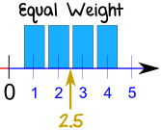
WEIGHTED MEAN
A mean where some values contribute more than others.
Example
When we do a simple mean (or average), we give equal weight to each number.
Here is the mean of 1, 2, 3 and 4:
Mean = 1 + 2 + 3 + 4 = 10 = 2.5 4 4

Slide 22
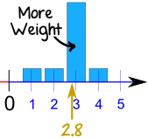
WEIGHTED MEAN
We could think that each of those numbers has a "weight" of ¼ (because there are 4 numbers):
Mean = ¼ × 1 + ¼ × 2 + ¼ × 3 + ¼ × 4
= 0.25 + 0.5 + 0.75 + 1 = 2.5
Now let's change the weight of 3 to 0.7, and the weights of the other numbers to 0.1 so the total of the weights is still 1:
Mean = 0.1 × 1 + 0.1 × 2 + 0.7 × 3 + 0.1 × 4
= 0.1 + 0.2 + 2.1 + 0.4 = 2.8

Slide 23
DISADVANTAGES OF MEAN
Disadvantage:
Sensitive to outliers .
For Skewed Data it is not suitable

Slide 24
MEAN
Trimmed Mean
Mean obtained after chopping off values at the high and low extremes.
The original mean = [1.1 +5.6 +8.9 +18.2 +19.1 +7.2 +8.2 +7.4 + 6.9 +15.5 +3.6 +4.7 +11.8 +12.4 +17.7+ 2.5 +10.3 +8.7 +7.1+ 6.4] /20 =183.3/20 = 9.165
The 10% trimmed mean = [5.6 +8.9 +18.2 +7.2 +8.2 +7.4 + 6.9 +15.5 +3.6 +4.7 +11.8 +12.4 +17.7+ 2.5 +10.3 +8.7 +7.1+ 6.4] /18 =163.1/18 = 9.0611111111

Slide 25
MEDIAN
The median is the middle score for a set of data that has been arranged in order of magnitude.
Given data set of N distinct values sorted in numerical order.
If N is ODD the median is the MIDDLE value of the ordered set.
If N is EVEN the median is average of middle two values.

Slide 26
EXAMPLE
{20, 30, 30, 30, 35, 39, 46, 58, 59} N=9
Median
{20, 30, 30, 30, 35, 39, 46, 58, 59} 5 th value.
If we add a 10th value, the median is the average of the 5th and 6th values:
{20, 30, 30, 30, 35, 39, 46, 58, 59, 60}
(35+39)/2 = 37

Slide 27
ADVANTAGES OF MEDIAN
The median is less affected by outliers
Better measure for skewed(asymmetric) data.
Disadvantages
Expensive for large data

Slide 28
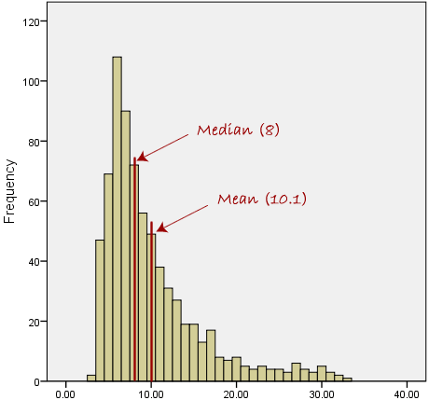
SKEWED DISTRIBUTIONS AND THE MEAN AND MEDIAN

Slide 29
APPROXIMATE THE MEDIAN
The data are grouped in intervals according to their xi data values and that the frequency of each interval is known.
We can approximate the median of the entire data set by interpolation using the formula:
f
L₁ = lower limit of the interval containing the median
width = width of the interval containing the median
(∑freq)l = cumulative frequency corresponding to the lower limit
freq _{median} = number of cases in the interval containing the median
Median = L₁ + width* [ N/2 – (∑freq)l ]
freq _{median}

Slide 30
EXAMPLE
Number of games | Frequency
1 - 5 | 2
6 - 10 | 7
11 - 15 | 8
16 - 20 | 3

Slide 31
EXAMPLE
Class width I=5
The No of Observation N: 20
Step1: Cumulative frequency
Number of games | Frequency | Cumulative Frequency
1 - 5 | 2 | 2
6 - 10 | 7 | 9
11 - 15 | 8 | 17
16 - 20 | 3 | 20

Slide 32
EXAMPLE
Step2: To Find Median class group
Use formula N/2= 20/2=10
The median class is the class whose CF is greater than and nearest to the value N/2
So the median class is 11-15 which is CF=17

Slide 33
EXAMPLE
Step3: Calculating Median
Lower bound of median class L=11/10.5
Cumulative frequency corresponding to the lower bound F= 9
The number of cases frequency=8;
Approximate Median= 11+5((10-9)/8)=11.625

Slide 34
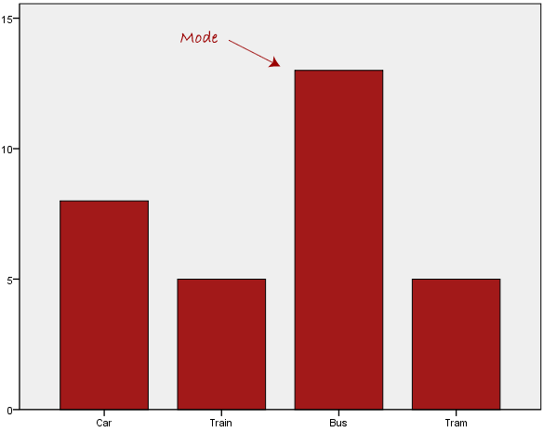
MODE
The most frequently occurring value (or category) in a data set.

Slide 35
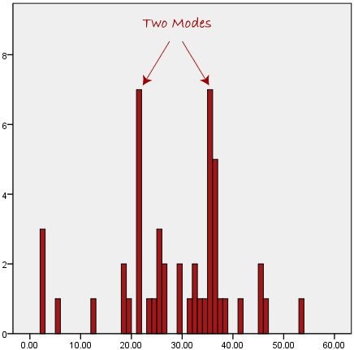
MODE
UNIMODEL- Single value
BIMODEL- Two values
TRIMODEL- three values
MULTIMODEL- More than three values
Mode can be used for left skewed data set.

Slide 36

MID RANGE
Mid range is the average of the largest and smallest values in the data set.
The mid-range is rarely used in practical statistical analysis.

Slide 37
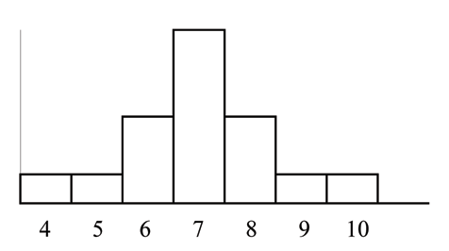
COMPARISON OF MEAN, MEDIAN AND MODE FOR SYMMETRIC AND SKEWED DATA
Consider the following data set: Symmetric Data
4 ; 5 ; 6 ; 6 ; 6 ; 7 ; 7 ; 7 ; 7 ; 7 ; 7 ; 8 ; 8 ; 8 ; 9 ; 10
The mean, Median and mode are same :7

Slide 38
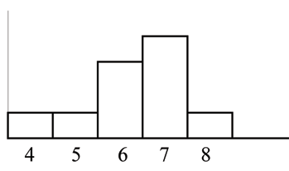
COMPARISON OF MEAN, MEDIAN AND MODE FOR SYMMETRIC AND SKEWED DATA
The histogram for the data: Left skewed Data
4 ; 5 ; 6 ; 6 ; 6 ; 7 ; 7 ; 7 ; 7 ; 8
The mean is 6.3, Median is 6.5, and the mode is 7.
Median and mode will work perfectly than Mean

Slide 39
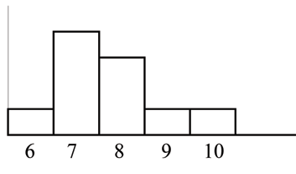
COMPARISON OF MEAN, MEDIAN AND MODE FOR SYMMETRIC AND SKEWED DATA
The histogram for the data:
6 ; 7 ; 7 ; 7 ; 7 ; 8 ; 8 ; 8 ; 9 ; 10
is also not symmetrical. It is skewed to the right.
The mean is 7.7, the median is 7.5, and the mode is 7.
Mode and Median will work perfectly than Mean

Slide 40
SUMMARY OF WHEN TO USE THE MEAN, MEDIAN AND MODE
Type of Variable | Best measure of central tendency
Nominal | Mode
Ordinal | Median
Interval/Ratio (not skewed) | Mean
Interval/Ratio (skewed) | Median/Mode

Slide 41
MEASURING THE DISPERSION OF DATA
The "spread" of a data set.
Common measures of dispersions are:
1.RANGE
2. FIVE NUMBER SUMMARY
3. INTERQUARTILE RANGE
4. STANDARD DEVIATION
5. VARIANCE

Slide 42
RANGE
The range is defined as the difference between the largest score in the set of data and the smallest score in the set of data
What is the range of the following data:
4 8 1 6 6 2 9 3 6 9
Answer is 9-1=8
When To Use the Range?
The range is used when
  you have ordinal data or
  you are presenting your results to people with little or no knowledge of statistics

Slide 43

PERCENTILE
Percentile: the value below which a percentage of data falls.
Example: You are the fourth tallest person in a group of 20
80% of people are shorter than you:
That means you are at the 80th percentile.

Slide 44
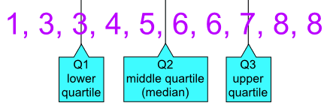
QUARTILES
Quartiles: which splits the data into quarters:
Example:1, 3, 3, 4, 5, 6, 6, 7, 8, 8
The numbers are in order. Cut the list into quarters:

Slide 45
QUARTILES
Quartile 1 (Q1) can be called the 25th percentile
Quartile 2 (Q2) can be called the 50th percentile
Quartile 3 (Q3) can be called the 75th percentile
The 25th percentile = 3
The 50th percentile = 5.5
The 75th percentile = 7

Slide 46
PERCENTILE, QUARTILES
Interquartile range (IQR)
* It is distance between the first and third quartile.
* simple measure of spread that gives the range
covered by the middle half of the data.
IQR= Q3-Q1
* It is very useful for describing the skew data

Slide 47
EXAMPLE -PERCENTILE, QUARTILES
50, 65, 70, 72, 72, 78, 80, 82, 84, 84
25 th percentile (Q1) =10*0.25= 2.5= 3rd position data is the 25 th percentile. 70
50 th percentile (Q2)= 10*0.50=5 ^{th} position data 72
75 th percentile (Q3)=10*0.75= 7.5=8 ^{th} position data. 82
IQR = Q3-Q1 = 82-70=12

Slide 48
FIVE NUMBER SUMMARY
Q1, Median and Q3 together contain no information about the end points of the data, a fuller summary of the shape of a distribution can be obtained by providing the lowest and highest data values as well.
The five-number summary provides a concise summary of the distribution of the observations.
It consists of:
1. Minimum value
2. Quartile Q1
3. Median Q2
4. Quartile Q3
5. Maximum value.

Slide 49
BOX PLOT
Box plots are popular way of visualizing a distribution. Box plot is a convenient way of graphically depicting groups of numerical data through their quartiles
Outlier
Large value-Whiskers
Quartile3 and 1
Median (Q2)
small value Whiskers

Slide 50
EXAMPLE
Consider the data set
12,15,23,24,30,31,33,36,50,73
Find Five number summary:
1. Minimum =12
2. Q1= 10*0.25= 2.5= 3 rd position data = 23
3. Q2= Median = (30+31)/2=30.5
4. Q3= 10*0.75=7.5=8th position data= 36
5. Maximum=73

Slide 51
TO FIND OUTLIER
(IQR* 1.5) +Q3 greater values are consider as outlier.
Q1-(IQR*1.5) Lesser than values are consider as outlier.

Slide 52
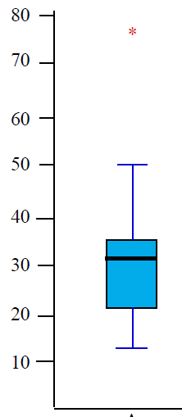
EXAMPLE- PLOTTING THE GRAPH

Slide 53
INTERPRETATION OF BOX PLOT
When you compare two or more data sets, focus on four features:
Center. Graphically, the center of a distribution is the point where about half of the observations are on either side.
Spread. The spread of a distribution refers to the variability of the data. If the observations cover a wide range, the spread is larger. If the observations are clustered around a single value, the spread is smaller.
Shape. The shape of a distribution is described by symmetry, skewness, number of peaks, etc.
Unusual features. Unusual features refer to gaps (areas of the distribution where there are no observations) and outliers.

Slide 54
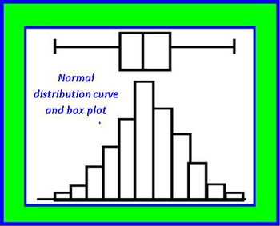
INTERPRETATION OF BOX PLOT
Normal Distribution:

Slide 55
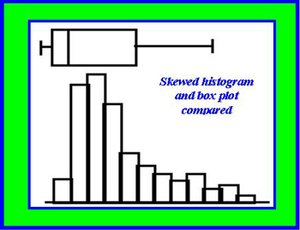
INTERPRETATION OF BOX PLOT
Skewed Data

Slide 56
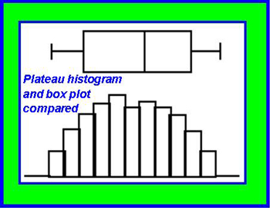
INTERPRETATION OF BOX PLOT
Plateau or a mountain with twin peaks.

Slide 57
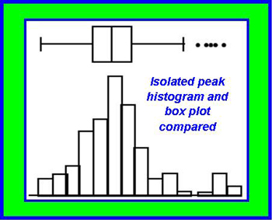
INTERPRETATION OF BOX PLOT
Small isolated peak.

Slide 58
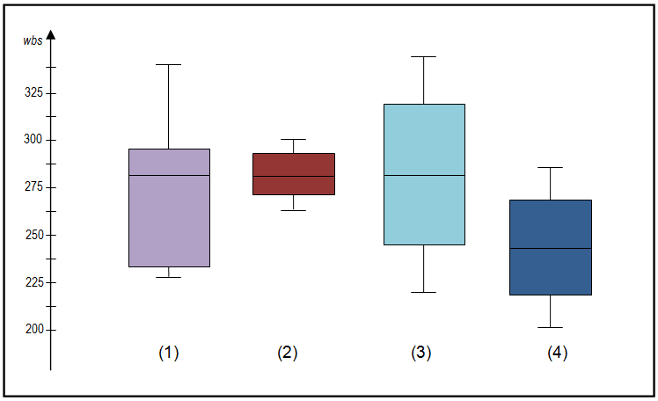
EXAMPLE

Slide 59

VARIANCE
The average of the squared differences from the Mean.

Slide 60

STANDARD DEVIATION
The Standard Deviation is a measure of how spread out numbers are.
Its symbol is σ
The formula is easy: it is the square root of the Variance.
The low Std Dev means the data observations tend to be closer to mean
The High Std Dev means the data observations are spread over a larger values

Slide 61
Age : 13,15,16,19,20,20,21,22,22,25,25,25,25,30,33,35,35,35,35,36,40,45,46,52,70.
Five number summary, box plot representation

Slide 62
GRAPHIC DISPLAYS OF DISPERSION DATA
Quantile plot
Quantile-Quantile plot
Histogram
Scatter plot

Slide 63
QUANTILE PLOT
Is a simple and effective way to have a first look at a univariate data distribution
It displays all of the data for the given attribute.
Plots Quantile information.
Steps:
1.Let xi for i=1 to N be the data sorted in increasing order. X₁ smaller value and X_{N} larger value.
2. Each observation is paired with percentage fi which indicates approximately fi*100% of data are below the value xi

Slide 64

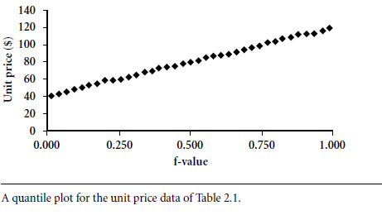
QUANTILE PLOT (Q PLOT)
Example

Slide 65
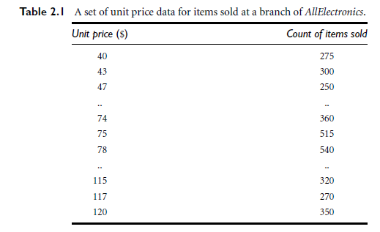
DATA

Slide 66
QUANTILE PLOT-QUANTILE PLOT
Comparing two data observations.
Combining two Q plots
Allows the user to view whether there is a shift in going from one distribution to another.

Slide 67
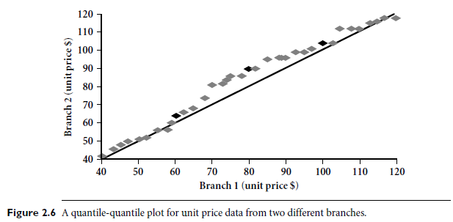
Q-Q PLOT
Example shows unit price of items sold at Branch 1 vs. Branch 2 for each quantile. Unit prices of items sold at Branch 1 tend to be lower than those at Branch 2.

Slide 68
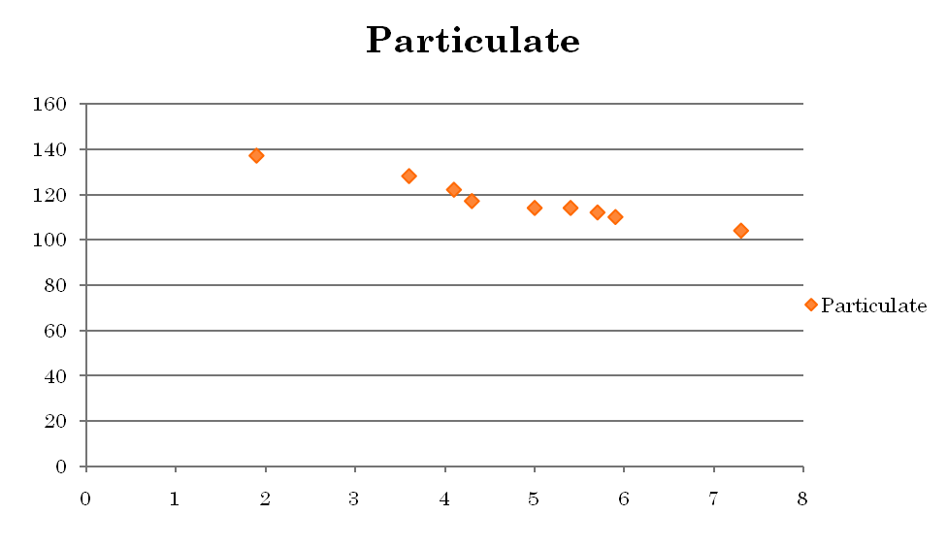
SCATTER PLOT
The scatter plot of all the people in the study would enable the researcher to obtain a visual comparison of the two variables in the data set, and will help to determine what kind of relationship there might be between the two variables.
Outliers can also be identified.

Slide 69


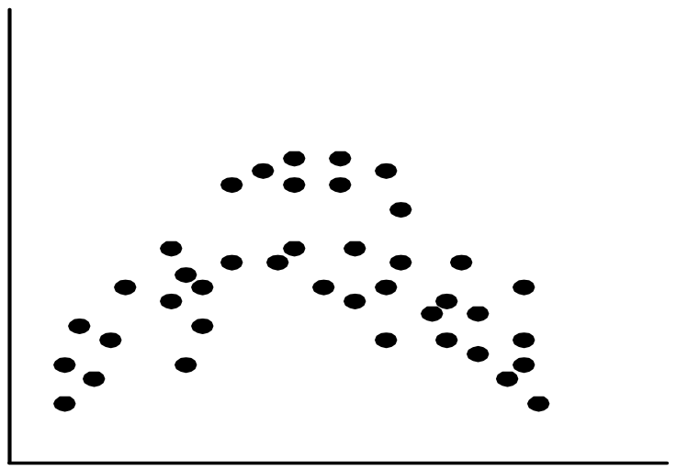
POSITIVELY AND NEGATIVELY CORRELATED DATA
The left half fragment is positively correlated
The right half is negative correlated

Slide 70


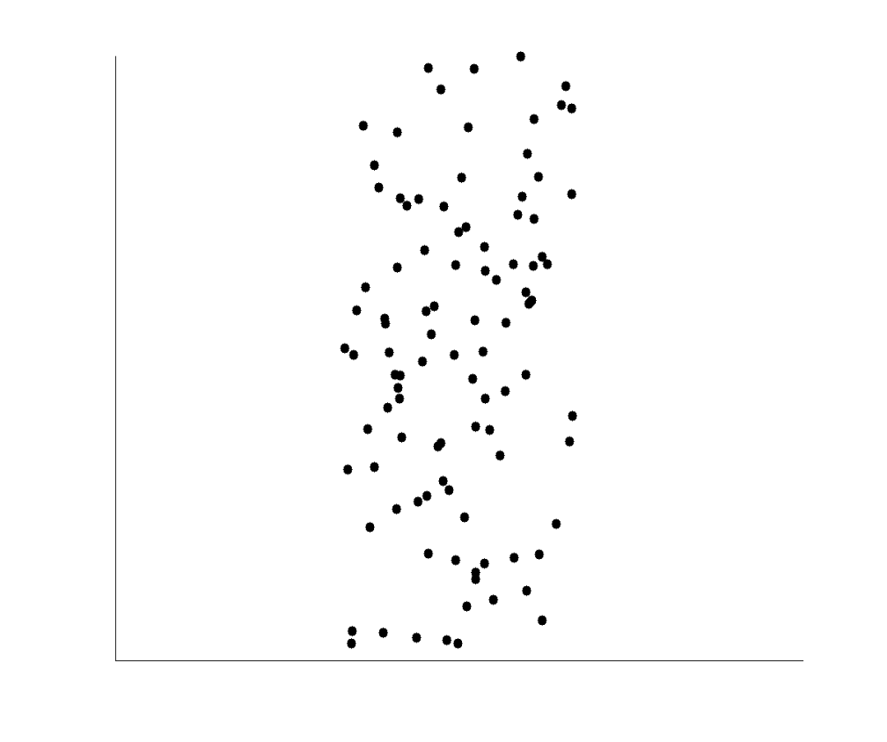
UNCORRELATED DATA

Slide 71
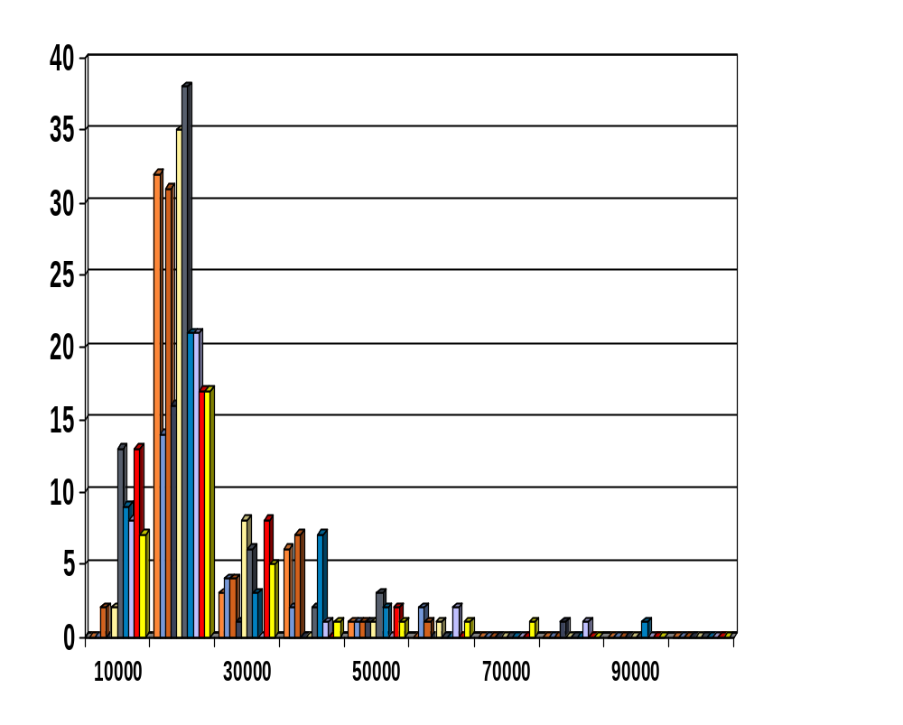
HISTOGRAM ANALYSIS
Histogram: Graph display of tabulated frequencies, shown as bars
It shows what proportion of cases fall into each of several categories
Differs from a bar chart in that it is the area of the bar that denotes the value, not the height as in bar charts, a crucial distinction when the categories are not of uniform width
The categories are usually specified as non-overlapping intervals of some variable. The categories (bars) must be adjacent

Slide 72
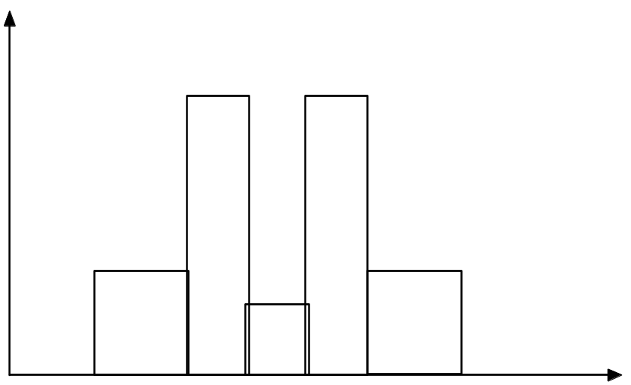
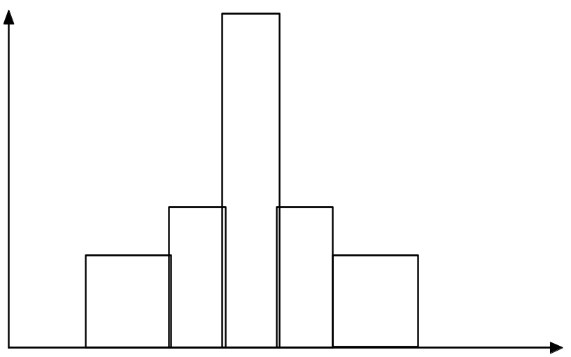
HISTOGRAMS OFTEN TELL MORE THAN BOXPLOTS
The two histograms shown in the left may have the same boxplot representation
  The same values for: min, Q1, median, Q3, max
But they have rather different data distributions

Slide 73
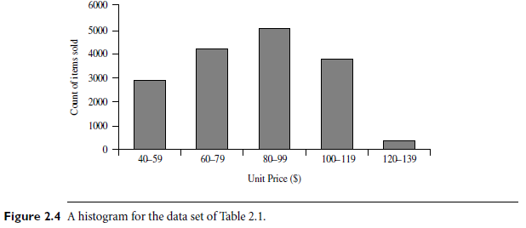
HISTOGRAM

